Slide 1
Capstone Project 3
Mobile price range prediction Submitted by: Kabeer Pande

Slide 2
Table of Content
Introduction
Problem Statement
Data Description
Data Cleaning
Exploratory Data Analysis
Machine learning Models
Data modeling
Conclusion

Slide 3
Introduction
● Nowadays, having a mobile phone is practically necessary to
stay in touch with the outside world. As a result, massive
amounts of mobile phones are getting manufactured and due
to that lot of data is also being generated.
● The expensive phones have a lot more features than
the cheap ones, mobile phone forecasts can be useful
for evaluating a phone's price range based on its
characteristics. This information can be used to inform
industry-level decisions on mobile phone specifications.

Slide 4
Problem Statement
In the competitive mobile phone market companies want to
understand sales data of mobile phones and factors which
drive the prices. The objective is to find out some relation
between features of a mobile phone(eg:- RAM, Internal
Memory, etc) and its selling price. In this problem, we do not
have to predict the actual price but a price range indicating
how high the price is.

Slide 5
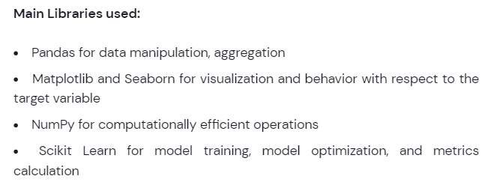
Libraries used

Slide 6
Dataset description
Battery_power -Total energy a battery can store in one time measured in mAh
Blue -Has Bluetooth or not
Clock_speed-speed at which microprocessor executes instructions
Dual_sim-Has dual sim support or not
Fc-Front Camera megapixels
Four_g-Has 4G or not
Int_memory-Internal Memory in Gigabytes
M_dep-Mobile Depth in cm
Mobile_wt-Weight of mobile phone
N_cores-Number of cores of processor
Pc -Primary Camera megapixels
Px_height-Pixel Resolution Height
Px_width-Pixel Resolution Width
Ram-Random Access Memory in Megabytes
Sc_h-Screen Height of mobile in cm
Sc_w-Screen Width of mobile in cm
Talk_time-longest time that a single battery charge will last when you are
Three_g-Has 3G or not
Touch_screen-Has touch screen or not
Wifi-Has wifi or not
Price_range-This is the target variable with value of 0(low cost), 1(medium cost), 2(high cost)

Slide 7

Dataset Cleaning
Dataset does not have any outliers.
Dataset does have any null values.
Dataset does not have any duplicate rows.

Slide 8
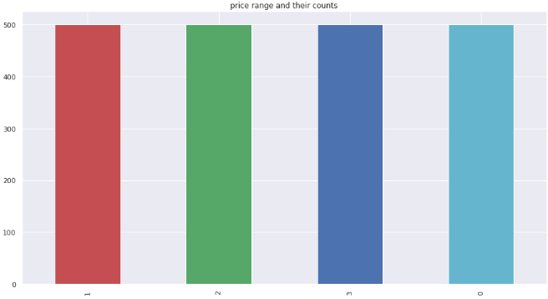
Exploratory Data Analysis
Price ranges of mobile phones.
There are 4 types of mobiles phones according to their price.

Slide 9
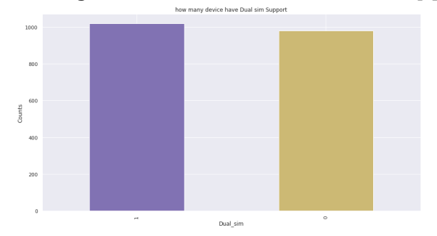
How many devices have dual sim?
50% of the devices support dual sim.

Slide 10
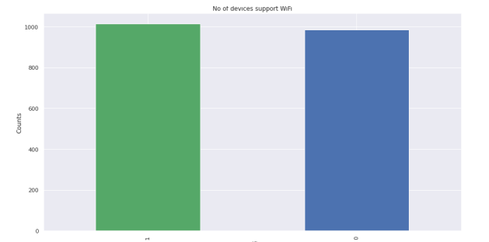
How many devices support wifi?
50% of the devices support wifi.

Slide 11
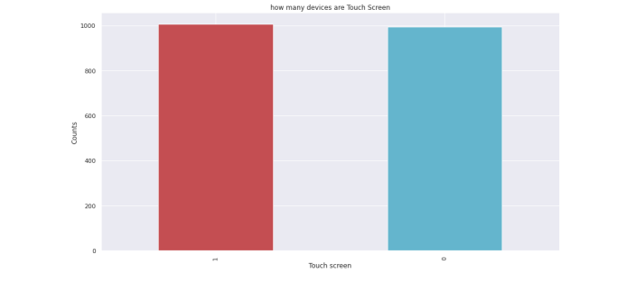
Count of touch screen devices
About 50% of the devices are touch screen.

Slide 12
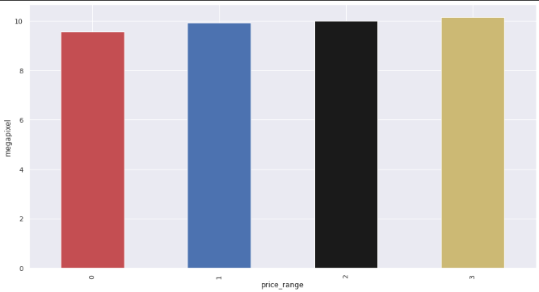
Average camera of each price range.
Average camera for each price range is between 9-10 megapixels.

Slide 13
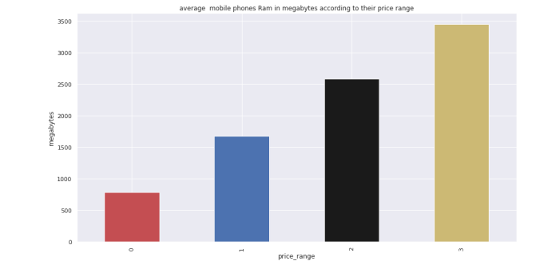
Average ram in megabytes according to their price range
Average ram for price range 0,1,2,3 is 800, 1700, 2600 and 3400 megabytes.

Slide 14
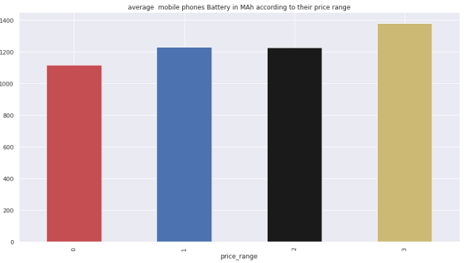
Average battery in mAh of each price range.
Average price range for price range 0,1,2,3 is 1100,1230,1230 and 1390 mAh. Price range 1 and 2 have
similar battery.

Slide 15
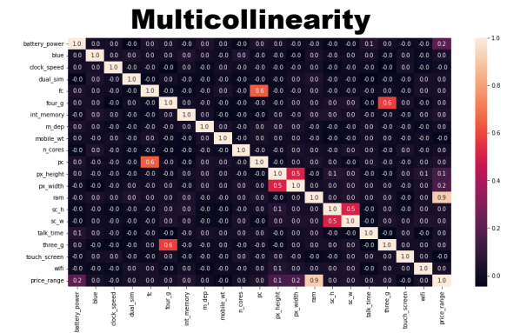
Checking multicollinearity
Our dataset does not contain any highly correlated data inputs therefore we don’t need to tackle multicollinearity.

Slide 16

Data modeling
First we assigned independent and dependent variables.
Then we did train test split in which data was split in the ratio of 20:80 where 20% is the test data and 80 % is the training data

Slide 17
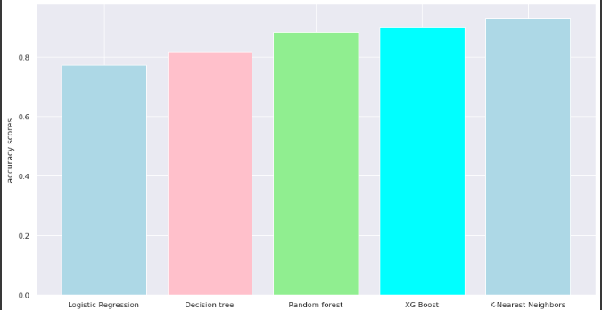
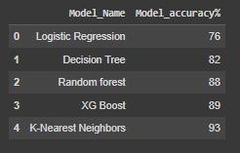
Machine learning models accuracy scores.
K-Nearest neighbours has the highest accuracy scores among all models.

Slide 18
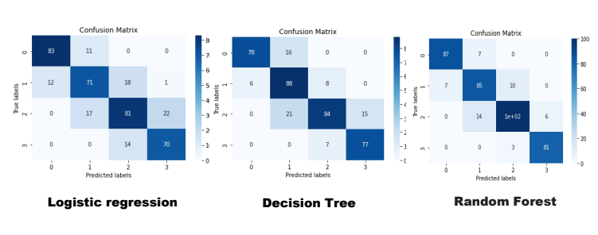
Confusion matrix of ML models

Slide 19
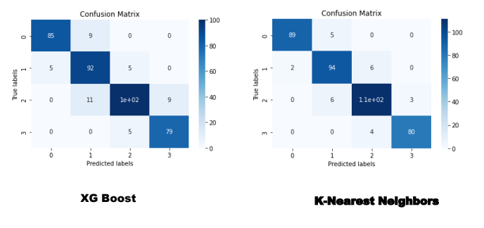

Slide 20
Conclusion
1: There are 4 types of mobile phones ,their price range labeled as 0,1,2,3 and all are present in equal counts.
2: Almost 50% of the mobile phones have dual sim.
3: Almost 50% of the mobile phones are Touch screen.
4: Almost 50% of the mobile phones have Wi-Fi connectivity.
5: For price range 0 the average battery is around 1100 mAh, for price range 1 and 2 it's around 1230mAh and for price range 3 it's around 1370 mAh.
6: The average ram for price range 0,1,2,3 is approx 700,1650,2600 and 3400 megabytes respectively.
7: The accuracy of logistic regression is 76% and it was the lest accuracy we got among all ML models.
8:The accuracy of Decision tree model is 82% .
9:The accuracy of Random forest model is 88%.
10:The accuracy of XGBoost model is 89%.
11:The accuracy of K-Nearest Neighbors model is 93%
12:So we conclude that K-Nearest Neighbors is our best model.

